Slide 1
GERD
Chrissy McCain MSN, RN
Fall 2024

Slide 2
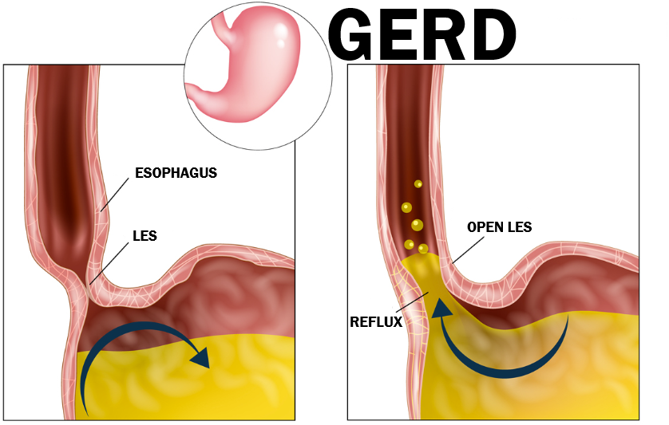

Slide 3
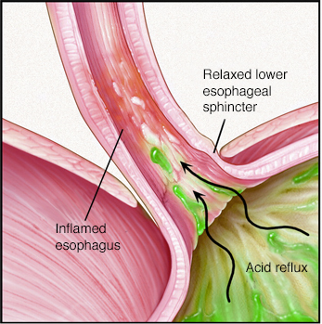
PATHOPHYSIOLOGY:
Normally, the LES prevents stomach contents from refluxing back into the esophagus.
In GERD, a weakened or relaxed LES allows regurgitation/reflux of stomach acids that causes inflammation of the esophagus causing damage, ulcers, scarring, tissue thickening, and can create cellular changes that may lead to cancer.

Slide 4
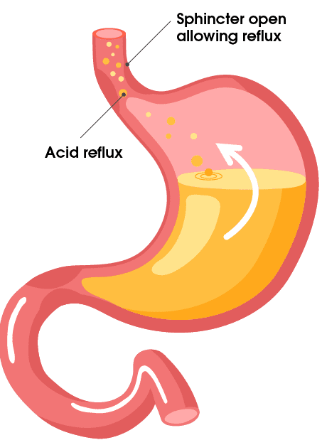
ETIOLOGY:
Weakened/relaxed LES allows reflux due to:
Increased abdominal pressure (ie: obesity, pregnancy, heavy lifting)
Delayed gastric emptying
Hiatal Hernia (part of stomach bulges through diaphragm)
Certain Medications*
*MEDS THAT AFFECT LES:
Weaken LES: Ca++ Channel Blockers, Theophyllines (asthma)
Decrease LES Tone: Opioids, Nitrates, Beta-agonists
Also meds that increase gastric acid production

Slide 5
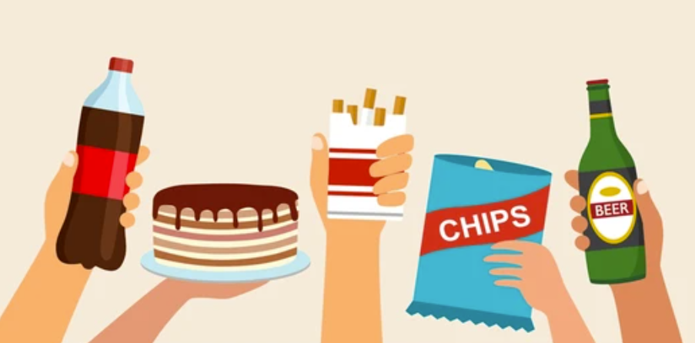
EXACERBATING FACTORS:
Caffeine (all sources; relaxes LES)
Certain Foods (that ↑ gastric acids)
Overeating & eating before sleep
Smoking/Nicotine (weakens LES & ↑acids)
Alcohol use/abuse

Slide 6
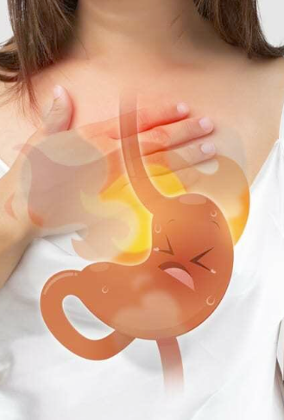
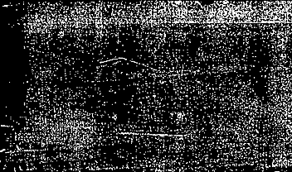
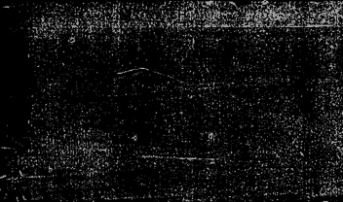
SIGNS & SYMPTOMS:
Heartburn
Acid reflux/regurgitation
Sore throat
Feeling of lump in throat
Dysphagia
Chronic cough
Nausea & vomiting
Chest pain

Slide 7
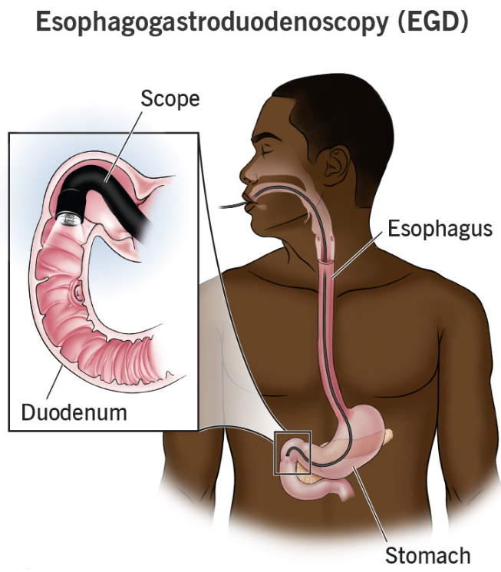
DIAGNOSTICS:
History & Physical Assessment
EGD (can biopsy for Barret’s Esophagus**)
Response to GERD medications
pH monitoring
Manometry (measure LES pressure/function)
**Barret’s esophagus – Chronic inflammation causes lining of lower esophagus to become damaged & thickened; Cellular structure of tissue begins to resemble intestinal cells. Increased risk for Cancer!! Important to monitor for malignant changes!

Slide 8
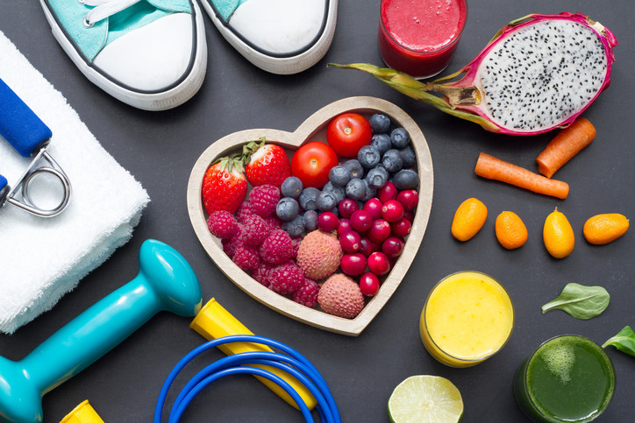
TREATMENT:
Lifestyle Modifications:
Weight Loss & avoid tight clothing
Eat smaller, more frequent meals
Avoid eating before bed
Sleep with head elevated
Avoid the bad foods!
Choose the good foods!
Drink plenty of water
Medications – see next slide!!
Surgical Treatment:
Nissen fundoplication – for severe cases that do not respond to the above
LINX device – ring of magnetic beads around LES to prevent reflux

Slide 9
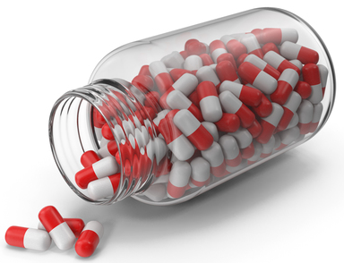
MEDICATIONS:
Medications that Neutralize stomach acid:
  Antacids – quick relief, don’t heal esophagus, have long-term use effects.
  Aluminum hydroxide (Mylanta)
  Calcium carbonate (Alka-Seltzer, Tums)
  Magnesium hydroxide (Milk of Magnesia)
Medications that reduce Acid Production:
  H2 Receptor Antagonist “H2A” – start working quicker than PPIs, shorter duration.
  Famotidine (Pepcid)
  Ranitidine (Zantac)
Medications that help to increase the Lower Esophageal Sphincter
  Cholinergic Classification
  Bathanechol (Urecholine)
  Prokinetic Classification
  Metoclopramide (Reglan)
Medications that block Acid production & help heal the esophagus:
  Proton Pump Inhibitors “PPI” – take longer to start working than H2As, but longer duration.
  Omeprazole (Prilosec)
  Pantoprazole (Protonix)

Slide 10
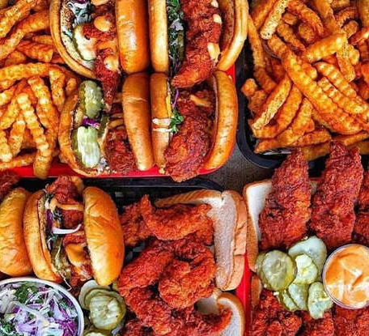
FOODS
THAT MAKE
IT WORSE
Spicy foods
Greasy foods
Highly-acidic foods
Processed snacks
Fatty foods
Carbonated drinks

Slide 11
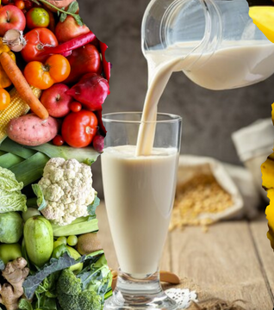
FOODS THAT MAKE IT BETTER
High-fiber foods
Non-citrus fruits
Vegetables
Alkaline foods
Healthy fats
Complex carbs
Lean proteins
High-water content foods

